Slide 2
Hand Gesture Recognition using OpenCV
Submitted to:
Department of Computer Science and Engineering

Slide 3
Supervised by: Prof. Gajendra Chauhan
Team Members
1. Kanishk Chouhan (0827CS201112)
2. Khushboo Sen (0827CS201114)
3. Mahak Soni (0827CS201127)
4. Mayank Solanki (0827CS201134)

Slide 4
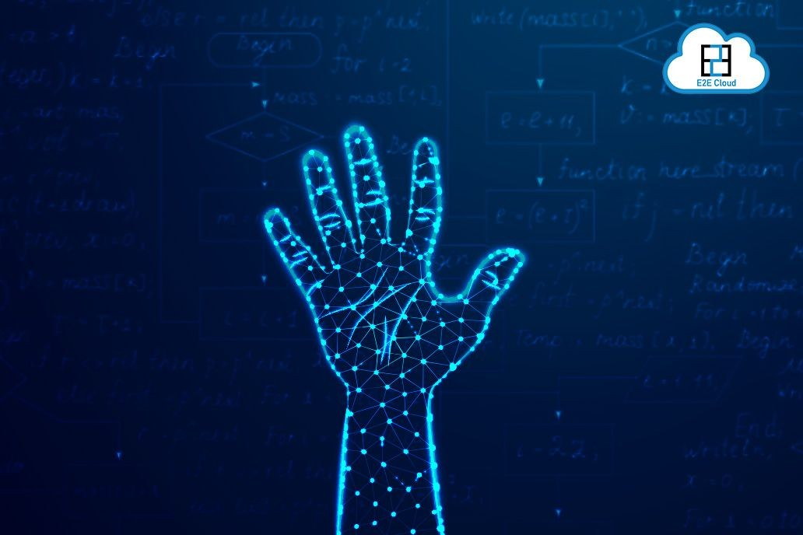
Project Presentation Outline
Abstract
Introduction
Problem Statement
Project Objectives
Survey of Existing Systems
Requirement Analysis
Solution Proposed
Methodology
Conclusions

Slide 5
Abstract
Developing a solution for Gesture for operating Laptops/PCs for frequently used operations such as saving a file, exiting an application, printing commands, system shutting down, etc.
Hand gesture recognition is one of the active research areas in the field of the human-computer interface due to its flexibility and user-friendliness. Gesture recognition technology is used to develop a system that can be used to convey information among disabled people or for controlling a device.

Slide 6
Introduction
Over a period, the generation has witnessed a paradigm shift- a switch that altered the entire practice that we employ to manage and operate electronic devices.
The digital era has welcomed gesture recognition software to meet the dynamic need of technological innovation, which can recognize hand and face movements and perform the assigned/asked task after that.
The software interprets human gestures using programmed mathematical algorithms.
It has facilitated every arena lying in the digital sphere of the world, such as a graphic designer who can correctly make changes in an image without using the keyboard or mouse.
An engineer can zoom in or zoom out on a 3-Dimensional representation of any model only by hand gestures when the device is in their hand. Gesture recognition technology has a lot of benefits by which human can direct their businesses and personal life.

Slide 7
Problem Statement
For any user, authenticated by face recognition, a few gestures could be defined for frequently used tasks- save, exit, print, screen lock, screen unlock, system shut down, and system restart. Save, print and exit operations are context-sensitive, which is applicable to the current application.
Similarly, a gesture could be defined as close/exit. If no application is opened, it will work as the system shuts down. It is similar to Alt+F4 key press functionality on windows PC.
For example, if the word document is open and the gesture for save is done then the document will be saved, if the gesture for print is given then the printer dialog will open etc.

Slide 8
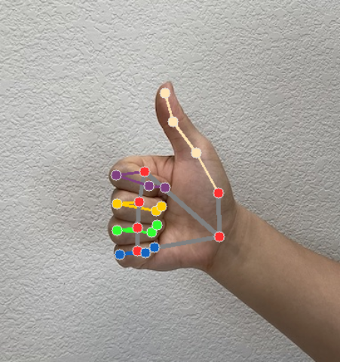
Objectives
The goal of this project is to develop a software system that allows the user/people to perform some frequently performed functions using gestures thus saving a lot of time.
Gesture recognition can be seen as a way for computers to begin to understand human body language. Compared to primitive user interfaces, such as keyboard and mouse, it builds a richer bridge between computers and humans.

Slide 9
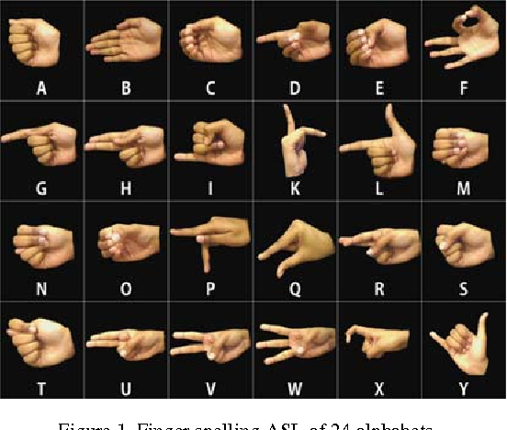
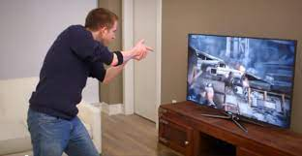
Survey of Existing Systems
Sign Language Recognition: A lot of systems have been proposed to recognize gestures using different types of sign languages. For example recognized American Sign Language ASL using boundary histogram, MLP neural network, and dynamic programming matching. recognized Japanese sign language JSL using Recurrent Neural Network, 42 alphabets, and 10 words. recognized Arabic Sign language ArSL using two different types of Neural Networks, Partially and Fully Recurrent neural Networks.
Television Control: Hand postures and gestures are used for controlling the Television device. In a set of hands, gestures are used to control the TV activities, such as turning the TV on and off, increasing and decreasing the volume, muting the sound, and changing the channel using open and closed hands.

Slide 10
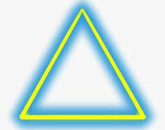
Survey of Existing Systems
Graphic Editor Control: Graphic editor control system requires the hand gesture to be tracked and located as a preprocessing operation. used 12 dynamic gestures for drawing and editing graphic systems. Shapes for drawing are; triangle, rectangular, circle, arc, horizontal, and vertical lines for drawing, and commands for editing the graphic system are; copy, delete, move, swap, undo, and close.

Slide 11
Requirement Analysis
Functional requirements
Real-time visualization of the system.
GUI is important to visualize the hand position.
Application will perform left, right, up & down motions by hand gestures.
Volume raise and slow down.
Save, exit, print & shut down.
Helps to measure the distance between hands and screen.

Slide 12
Requirement Analysis
Non-Functional requirements :
Usability: The user is facilitated with the control section for the entire process in which they can arrange the position of the hand at the center of ROI under consideration, the variation of palm position and respective command generation, etc can be effectively facilitated by means of the user interface.
Security and support: The application will be permissible to be used only in a secure network so there is less feasibility of insecurity over the functionality of the application.
Maintainability: The installation and operation manual of the project will be provided to the user.
Extensibility: The project work is also open for any future modification and hence the work could be defined as one extensible work.

Slide 13
Solution Proposed
The proposed Gesture controlled mouse system can be used to overcome problems in the real world such as situations where there is no space to use a physical mouse additionally for those who have hand issues and are unable to use a physical mouse.
Moreover, there are various other problems like the Physical mouse being subjected to mechanical wear and tear. It requires special hardware and a surface to operate. It is not easily adaptable to different environments and its performance varies depending on the environment.
Even in the current operational contexts, the mouse’s capabilities are limited. All wired mouse and wireless mouse have a lifespan so the proposed mouse can be used to overcome these problems since hand gesture and hand Tip detection is utilized to operate the PC mouse using a webcam or an internal camera.

Slide 14
METHODOLOGY
PROPOSED ALGORITHM
Gesture Controlled Mouse
Initialization of Camera: The camera is utilized through an image as the user's finger moves in the camera window, it is essential to correlate the resolution of the system screen with the resolution of the camera window being used. So, it becomes important to determine how many pixels are moved on the actual screen if the user moves by 1 pixel in the camera window.
Mapping and Extraction of all Hand Gestures: All the different gestures are going to be used acquisition toolkit in order to capture the user's moving finger. A minimum of 15 frames per second must be the camera's capture rate.

Slide 15
METHODOLOGY
PROPOSED ALGORITHM
Gesture Controlled Mouse
Co-relating the Resolution of the Camera Window and Screen: Because the cursor will move across the entire screen are allocated binary numbers for mapping. Mediapipe package is used for extraction of different landmarks of the hand which is used to recognize gestures. Hand detection is done by the subtraction method which is easy and effective to detect the hand region from the original image. The binary numbers given are useful in finger and palm segmentation.
Recognition and Execution of Hand Gestures: Finally, after successful mapping and extraction of different landmarks of the hand meaningful hand gestures are recognized and executed. This is done with the help of both OpenCV and Mediapipe modules. Depending on how many and what kinds of fingers are found, hand gestures can be anticipated. What fingers are detected depends on the content of the fingers. For example, if five fingers are detected it is classified as a neutral gesture, if two fingers are detected it is classified as a move cursor gesture, if the right finger is pulled down it is classified as a right click, etc.

Slide 16
METHODOLOGY
Steps to solve the project:
Import necessary packages.
import numpy
import cv2
import media pipe
import tensorflow
from tensorflow.keras.models import load_model
Initialize models.
Read frames from a webcam.
Detect hand key points.
Recognize hand gestures.

Slide 17
METHODOLOGY
IMPLEMENTATION
Camera: Using the Python computer vision library OpenCV, the video capture object is created, and the webcam will begin to capture video. The webcam then captures the frames and passes the ones to the AI virtual machine.
Video Capture: It basically captures an image of a finger, which one is up, and based on the information found in the library it performs the mouse functionality accordingly.
Hand Movement: Mouse Features Using Computer Vision to Determine Hand Gestures and Hand Tip Detection Cursor Moving: the index and middle fingers are up for the Moving Function.

Slide 18
METHODOLOGY
IMPLEMENTATION
Left Button Click: Left button click is made possible by wide opening the index finger and dragging it onto the file or folder.
Right Button Click: Wide opening the middle finger and dragging it onto the file or folder to explore more activities on it enables the right button to click.
Scroll Up/Down: The computer is designed to accomplish the mouse operation of scrolling up and down by merely pinching, which is done by connecting the tips of the index and middle fingers to the screen's scroll bar.

Slide 19
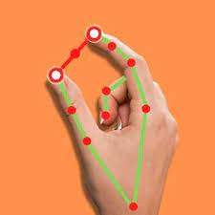
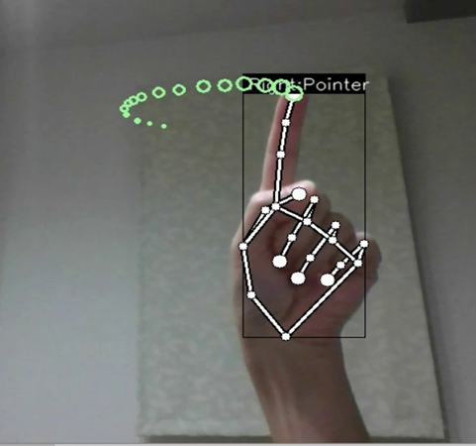
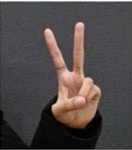
Some Hand Gestures…

Slide 20
Conclusion
Hand gesture recognition is of great importance for human-computer interaction (HCI) because of its extensive applications in virtual reality and sign language recognition etc. The human hand is very smaller with very complex articulations compared with the entire human body and therefore errors can be easily affected.

Slide 21
Acknowledgment
We would like to extend our heartfelt gratitude to our computer science and engineering department for giving us this great opportunity to work on this project.
We would also like to express our sincere gratitude to Prof. Gajendra Chauhan for his valuable guidance and kind supervision throughout the course of this project.

Slide 22
Q&A

Slide 23
THANKS

